Slide 1
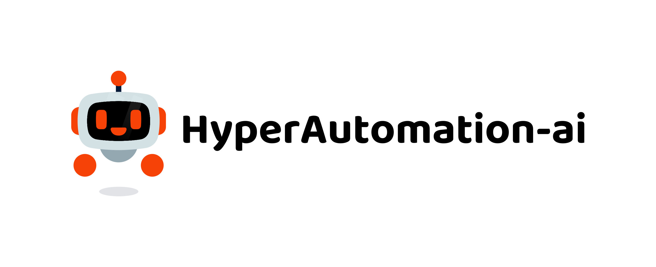
RPA Free Training program

Slide 2


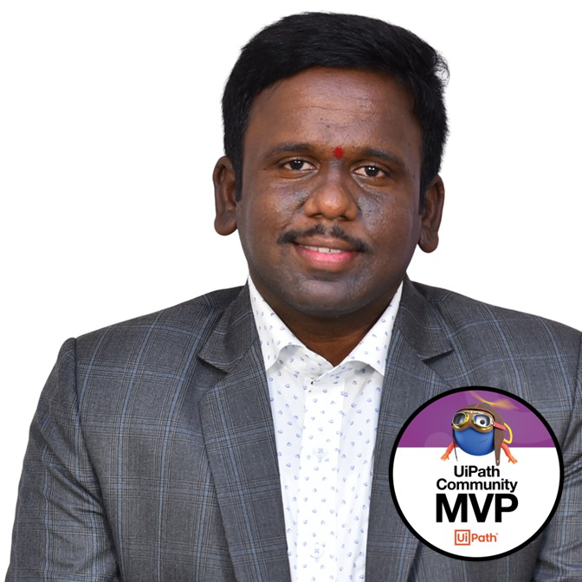
UiPath Document Understanding
Sai Kiran
Kondreddy
Sr RPA Developer
Process documents intelligently
Recognized by the UiPath team as MVP (Most Valuable Professional) 2024
UiPath Certified Advance Developer , Test Automation Engineer
Trained 500+ Students
UiPath Community Speaker and Mentor
Automation Technical Lead, Accelirate

Slide 3
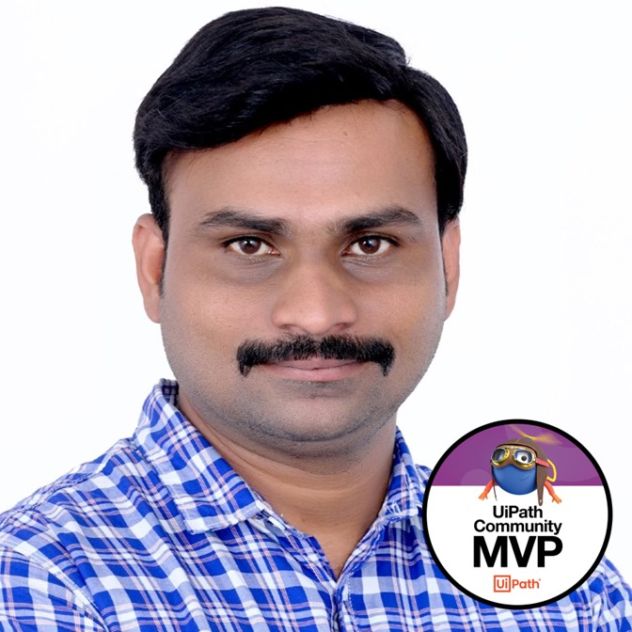
Pathrudu
Chintakayala
UiPath Document Understanding
Solution Architect
Process documents intelligently
Recognized by the UiPath team as MVP (Most Valuable Professional) 2024
UiPath Certified Solution Architect
Certified SAFe Agilist 6.0
UiPath Community Chapter Lead Visakhapatnam
Automation Technical Lead, Accelirate

Slide 4
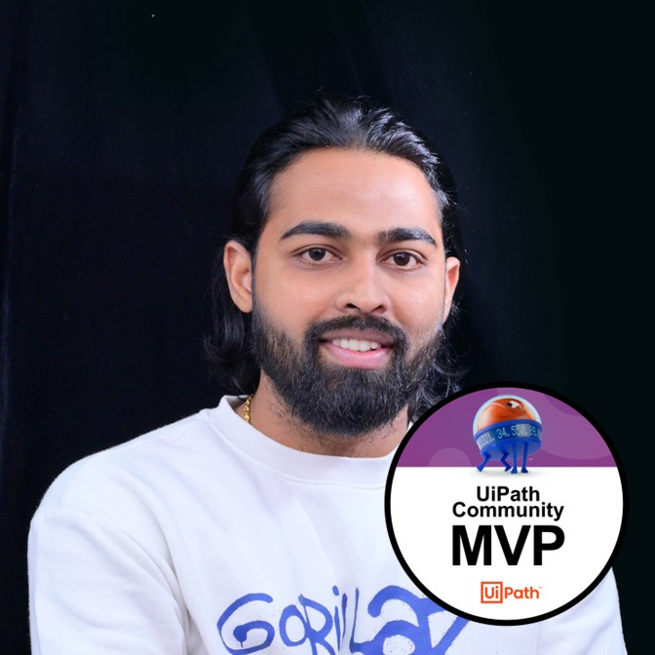
UiPath Document Understanding
Pradeep
Chinnala
Process documents intelligently
Sr Automation Consultant
Recognized by the UiPath team as MVP (Most Valuable Professional) in 2023 & 2024
𝐀𝐈 𝐚𝐭 𝐖𝐨𝐫𝐤 𝐇𝐚𝐜𝐤𝐚𝐭𝐡𝐨𝐧 2023 Finalist.
𝐆𝐞𝐧𝐞𝐫𝐚𝐭𝐢𝐯𝐞 𝐀𝐈 + 𝐒𝐩𝐞𝐜𝐢𝐚𝐥𝐢𝐳𝐞𝐝 𝐀𝐈 𝐂𝐨𝐦𝐦𝐮𝐧𝐢𝐭𝐲 Challenge Winner
Best AI Use Case Awards 2023 Winner
mation Technical Lead, Accelirate

Slide 5

Why you should join
Purpose
Offer free UiPath training to empower individuals and enhance their career prospects.
Importance
Highlight the growing demand for automation skills and UiPath's leading role in the field.
Community Building
Foster a supportive community for learners to connect and collaborate.
Driving Innovation and Growth
Equip learners with skills to drive innovation and contribute to economic growth.
Commitment to Lifelong Learning
Align with the broader mission of promoting continuous skill development
Transformational Impact
Illustrate the transformative impact on individuals, organizations, and communities, leading to a more efficient and inclusive society.

Slide 6
Vibrant ecosystem of nearly 1 million professionals and citizen developers learning, getting support, and succeeding together in their automation careers.
Automation Cloud
Start with the free Community Edition to get trained and certified
Academy
Learn the skills of the future on UiPath Academy or through our Academic Alliance
Earn globally recognized credentials with UiPath Certifications
Forum
Get crowdsourced support and share product feedback on UiPath Forum
Check the product documentation
Join the Insider Preview for early testing
Community Events
Connect with like-minded people and share best practices with the UiPath Community
Solve challenges in engaging hackathon competitions
Join meetups and conferences
Blog and Tutorials
Access the latest articles and video tutorial content created by community members and UiPath engineers in our Community Blog
Contribute as an author.
UiPath Community MVPs
Get recognized as a Most Valuable Professional (MVP)or one of the Forum Leaders, based on the contribution to others’ growth
Join the UiPath Community

Slide 7






